Slide 1




PDS
slido.com
Computer Vision
https://github.com/siagianp
https://www.youtube.com/@AmelOline/videos
https://github.com/amelcharolinesgn2/Cloud-Infrastructures
https://github.com/amelcharolinesgn2/ClouD-Infrastructure-SISKA-2025
https://github.com/amelcharolinesgn2/CCNA1
https://github.com/amelcharolinesgn2/CCNA2
https://github.com/amelcharolinesgn2/AWS Certificate
Notes:
Lab Session 01: AWS Compute Foundations – EC2, Networking, and Application Deployment Lab Session 02: Identity and Access Control with IAM Lab Session 03: Cloud Storage Solutions – S3, EBS, and EFS Lab Session 04: Database Services – RDS, DynamoDB, and ElastiCache Lab Session 05: Load Balancing and Auto Scaling Lab Session 06: Container Orchestration with ECS, Fargate, and EKS Lab Session 07: Serverless Computing with Lambda Lab Session 08: Monitoring, Logging, and Security Auditing Lab Session 09: Infrastructure as Code – CloudFormation, CDK, and Terraform Lab Session 10: CI/CD Pipelines – App Runner, CodePipeline, GitHub Actions, and CodeDeploy Lab Session 11: AI/ML Services – Rekognition, Comprehend, Translate, and SageMaker Lab Session 12: Hybrid Cloud Networking – VPC Peering, Transit Gateway, VPN, and Direct Connect Lab Session 13: Security and Compliance – AWS Config, GuardDuty, Security Hub, and KMS Lab Session 14: Disaster Recovery and Business Continuity – AWS Backup, Multi-Region, and Failover Lab Session 15: Migration and Modernization – DataSync, DMS, MGN, Containers, and Serverless
Lab Session 16: Cost Management and Optimization – Cost Explorer, Trusted Advisor, Budgets, and Well-Architected
https://www.youtube.com/watch?v=SOTamWNgDKc&t=19604s

Slide 2



Do not edit
How to change the design
Join at slido.com
Presenting with animations, GIFs or speaker notes? Enable our Chrome extension
Notes:
📣 This is Slido interaction slide, please don't delete it.
✅ Click on 'Present with Slido' and the joining instructions will appear when you get to this slide.

Slide 3

Do not edit
How to change the design
What is Infrastructure as a Code (IaC)? Give an example.
Presenting with animations, GIFs or speaker notes? Enable our Chrome extension
Notes:
📣 This is Slido interaction slide, please don't delete it.
✅ Click on 'Present with Slido' and the poll will launch automatically when you get to this slide.

Slide 4
Quiz 3 Topics
22. AWS Security: KMS, WAF, and Shield
23. Capacity Planning & Cloud Brokers
24. Service-Level Agreements (SLAs) in Cloud Computing
25. CI_CD_ Streamlining Software Delivery
26. Serverless Computing
27. IAC(Cloudformation), Monitoring & Logging

Slide 5

Do not edit
How to change the design
What is your Quiz 2 experience?
Presenting with animations, GIFs or speaker notes? Enable our Chrome extension
Notes:
📣 This is Slido interaction slide, please don't delete it.
✅ Click on 'Present with Slido' and the poll will launch automatically when you get to this slide.

Slide 6
AWS Budget and Cost Optimisation
Cost Optimization & Budgeting Tools - Pricing Calculator

Slide 7

Introduction to Cost Optimization & Budgeting Tools
Cost Optimization in AWS focuses on minimizing expenses while maintaining performance and security.
Key Factors:
  Right-Sizing Resources
  Choosing the Right Pricing Model (On-demand, Reserved Instances, Spot Instances)
  Monitoring and Automation
AWS Budgets

Slide 8
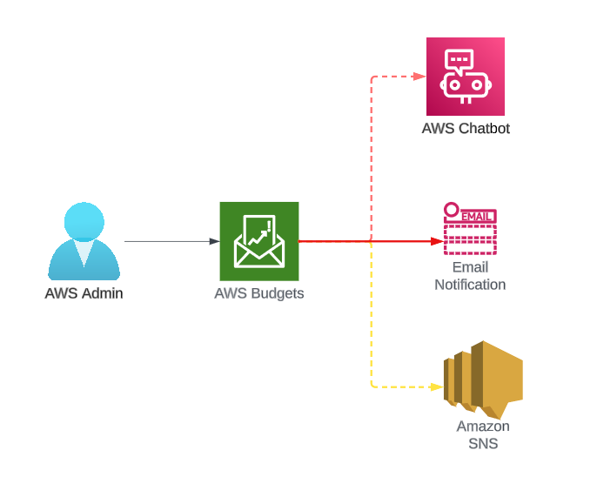

Slide 9
Do not edit
How to change the design
Which of the following is NOT a key factor in AWS cost optimization?
Presenting with animations, GIFs or speaker notes? Enable our Chrome extension
Notes:
📣 This is Slido interaction slide, please don't delete it.
✅ Click on 'Present with Slido' and the poll will launch automatically when you get to this slide.

Slide 10
AWS Pricing Models Overview
On-Demand Instances: Pay-as-you-go.
Reserved Instances: 1 to 3-year commitment for discounted pricing.
Spot Instances: Up to 90% discount but can be interrupted.
Savings Plans: Flexible pricing for consistent usage.

Slide 11
Do not edit
How to change the design
Which AWS pricing model provides the highest discount but with the risk of interruption?
Presenting with animations, GIFs or speaker notes? Enable our Chrome extension
Notes:
📣 This is Slido interaction slide, please don't delete it.
✅ Click on 'Present with Slido' and the poll will launch automatically when you get to this slide.

Slide 12
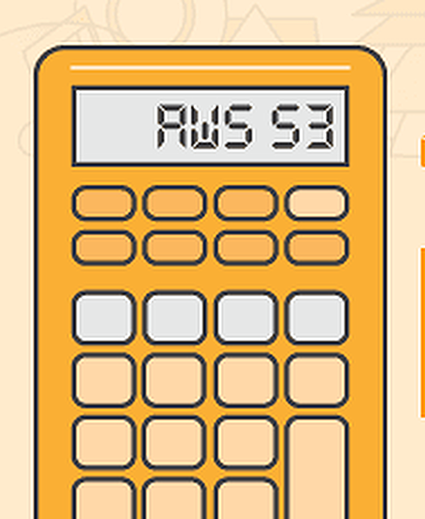
What is AWS Pricing Calculator?
A tool to estimate AWS service costs.
Helps in planning and forecasting.
Supports all major AWS services.
URL:
  https://calculator.aws/

Slide 13
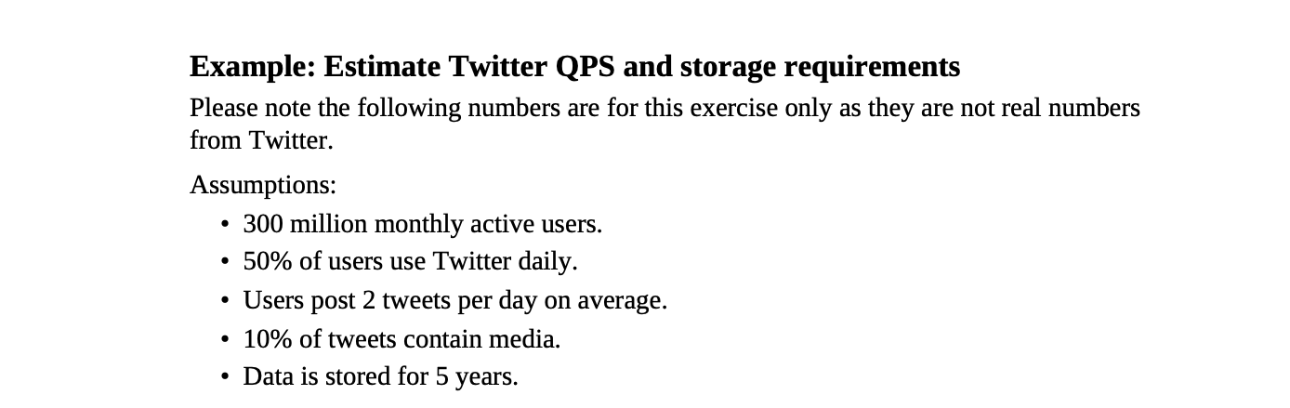
Find the QPS and Storage Requirement

Slide 14
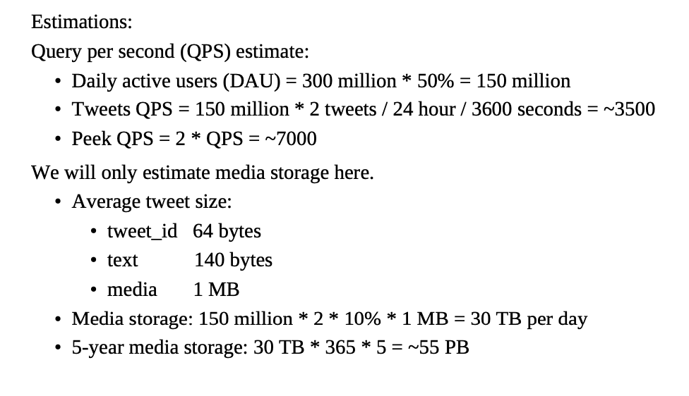
Solution:

Slide 15
Do not edit
How to change the design
What is the primary purpose of AWS Pricing Calculator?
Presenting with animations, GIFs or speaker notes? Enable our Chrome extension
Notes:
📣 This is Slido interaction slide, please don't delete it.
✅ Click on 'Present with Slido' and the poll will launch automatically when you get to this slide.

Slide 16
Key Features of AWS Pricing Calculator
Detailed Estimates: Resource-level cost breakdown.
Export and Share Estimates.
Customization: Customize pricing based on regions, storage, data transfer, etc.
Savings Estimates: Compare On-Demand vs Reserved pricing.

Slide 17
Do not edit
How to change the design
Which of the following is NOT a feature of AWS Pricing Calculator?
Presenting with animations, GIFs or speaker notes? Enable our Chrome extension
Notes:
📣 This is Slido interaction slide, please don't delete it.
✅ Click on 'Present with Slido' and the poll will launch automatically when you get to this slide.

Slide 18
Using AWS Pricing Calculator – Step-by-Step
Choose Services – Select EC2, S3, RDS, etc.
Configure Requirements – Instance type, storage, region.
Estimate Costs – Check pricing breakdown.
Compare Pricing Models – On-demand vs Reserved.
Export & Share Report.

Slide 19
Do not edit
How to change the design
Which is the first step when using AWS Pricing Calculator?
Presenting with animations, GIFs or speaker notes? Enable our Chrome extension
Notes:
📣 This is Slido interaction slide, please don't delete it.
✅ Click on 'Present with Slido' and the poll will launch automatically when you get to this slide.

Slide 20
AWS Budgets Tool
What is AWS Budgets?
Set custom cost and usage budgets.
Receive alerts via email or SNS.
Track actual vs forecasted spend.
Supports: Service, Linked Accounts, Tags.
AWS Budgets

Slide 21
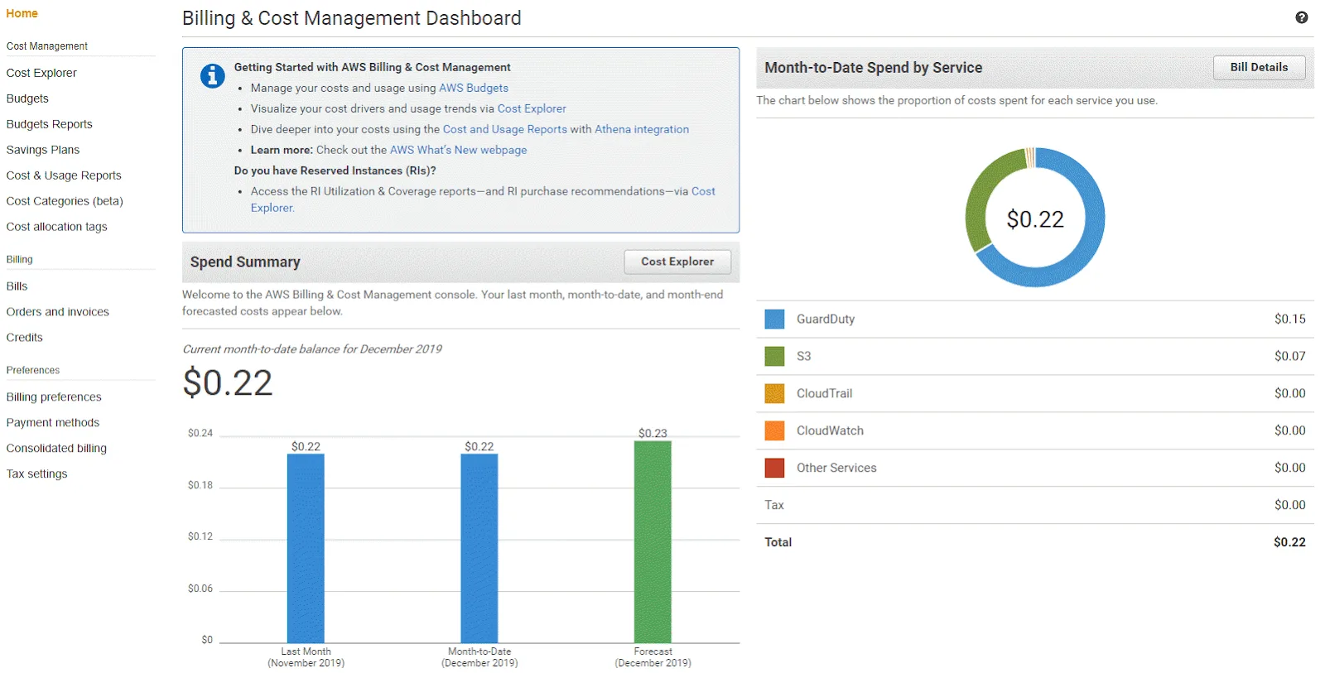

Slide 22
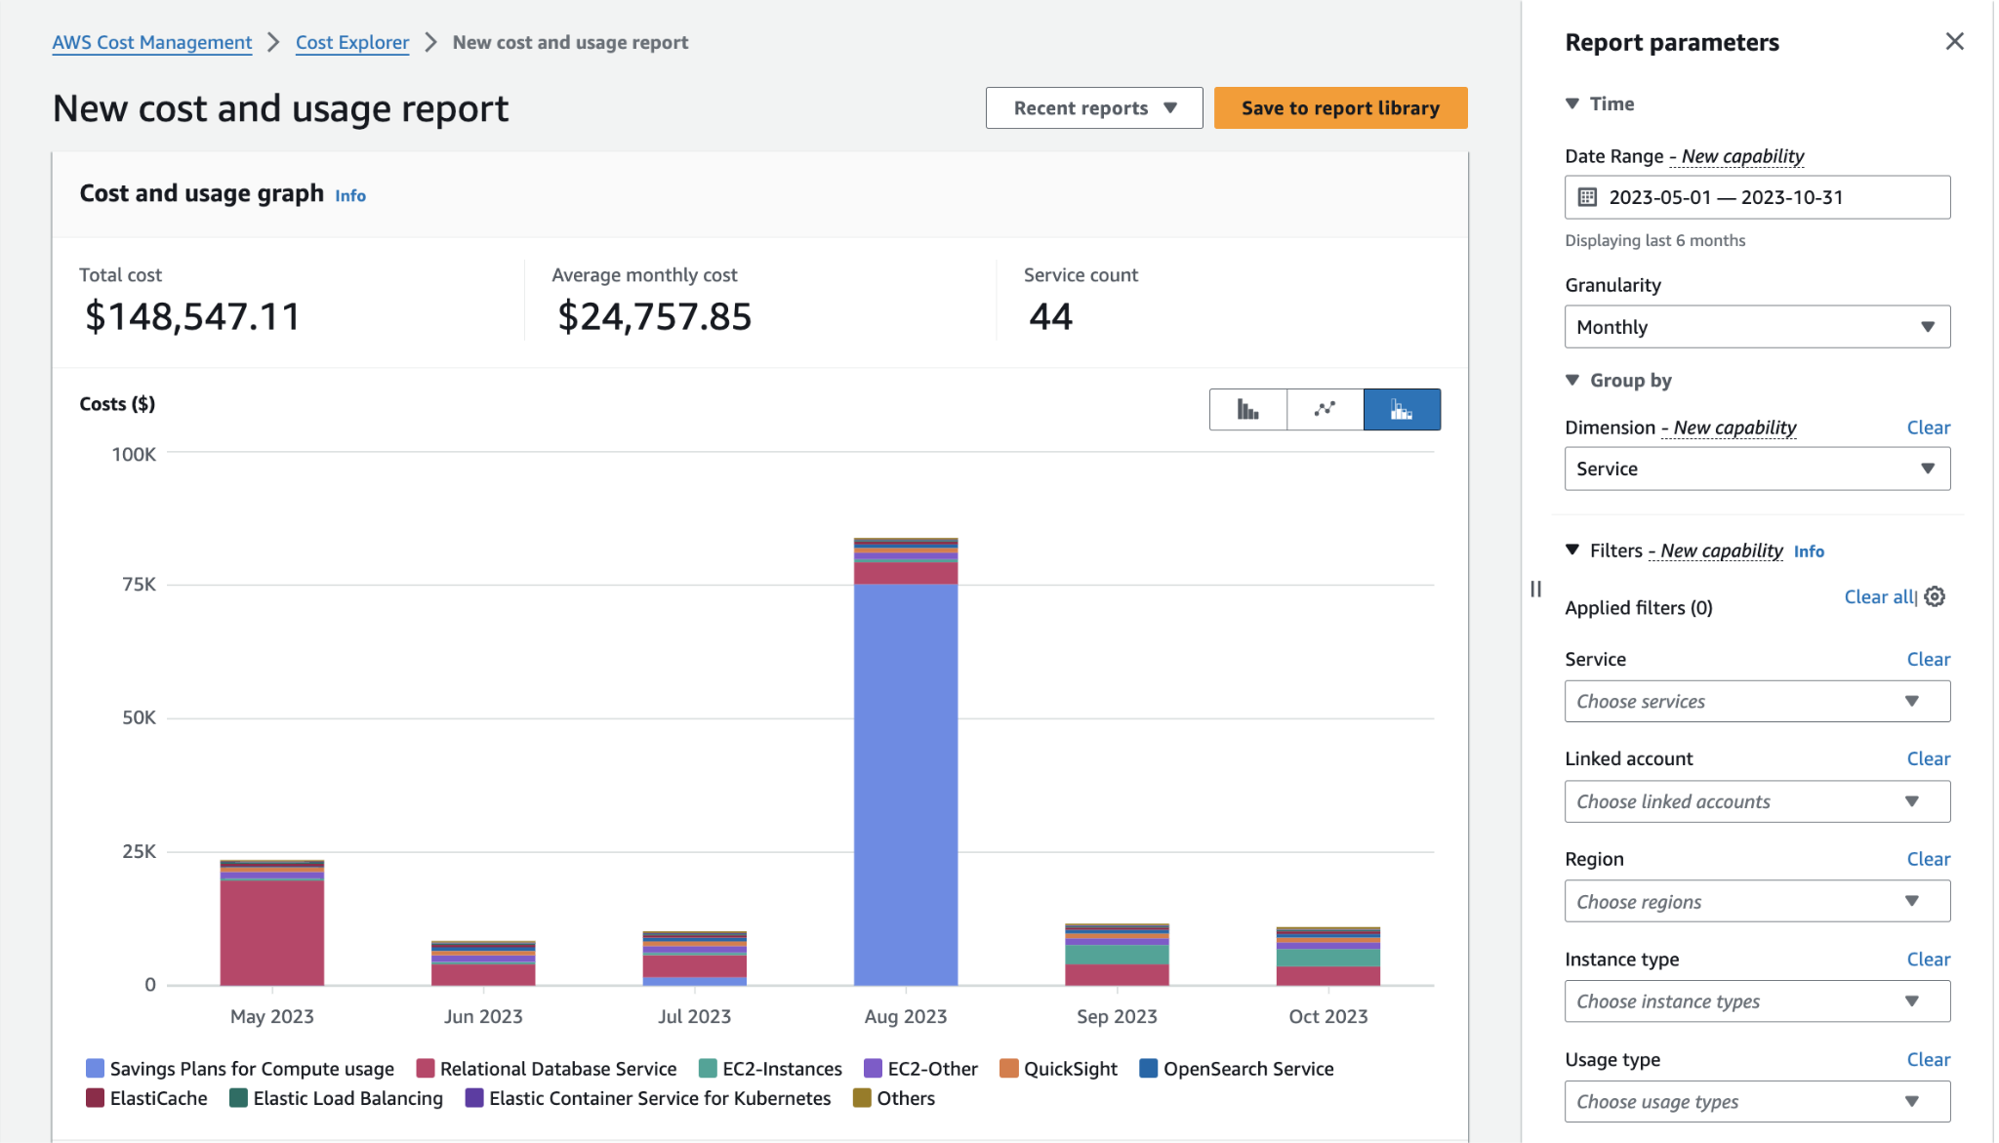

Slide 23
Do not edit
How to change the design
What can AWS Budgets NOT alert you about?
Presenting with animations, GIFs or speaker notes? Enable our Chrome extension
Notes:
📣 This is Slido interaction slide, please don't delete it.
✅ Click on 'Present with Slido' and the poll will launch automatically when you get to this slide.

Slide 24
AWS Cost Explorer
What is AWS Cost Explorer?
Visualize and analyze AWS spending.
Track spend trends over time.
Forecast future costs.
Granular Filtering: By service, linked account, region, etc.

Slide 25
Do not edit
How to change the design
What does AWS Cost Explorer primarily help with?
Presenting with animations, GIFs or speaker notes? Enable our Chrome extension
Notes:
📣 This is Slido interaction slide, please don't delete it.
✅ Click on 'Present with Slido' and the poll will launch automatically when you get to this slide.

Slide 26
Best Practices for Cost Optimization
Enable AWS Budgets & Alerts.
Use Reserved & Spot Instances when possible.
Right-size Instances & Storage.
Use Auto Scaling.
Monitor with Cost Explorer.

Slide 27
Do not edit
How to change the design
Which of the following is NOT a cost optimization best practice?
Presenting with animations, GIFs or speaker notes? Enable our Chrome extension
Notes:
📣 This is Slido interaction slide, please don't delete it.
✅ Click on 'Present with Slido' and the poll will launch automatically when you get to this slide.

Slide 28
Real Life scenario
A startup is building a web application on AWS. Initially, they deployed all EC2 instances as On-Demand. Their monthly AWS bill is higher than expected. They want to reduce costs without compromising performance for predictable workloads.

Slide 29
Real Life scenario
A startup is building a web application on AWS. Initially, they deployed all EC2 instances as On-Demand. Their monthly AWS bill is higher than expected. They want to reduce costs without compromising performance for predictable workloads.
Use Reserved Instances for predictable traffic.
Use Spot Instances for flexible or batch workloads.
Set up AWS Budgets for monthly cost alerts.
Use AWS Pricing Calculator to estimate and compare costs.

Slide 30
Questions 2
A company has moved its internal CRM system to AWS. They want to predict their monthly cloud bill and monitor if spending exceeds 80% of their budget.
Question:
Which AWS tools should they use to estimate and monitor costs? Explain how these tools will help.

Slide 31
Questions 2
A company has moved its internal CRM system to AWS. They want to predict their monthly cloud bill and monitor if spending exceeds 80% of their budget.
Question:
Which AWS tools should they use to estimate and monitor costs? Explain how these tools will help.
Use AWS Pricing Calculator to estimate costs based on their infrastructure.
Use AWS Budgets to set a monthly budget and get alerts when spending exceeds 80%.

Slide 32

Do not edit
How to change the design
Audience Q&A
Presenting with animations, GIFs or speaker notes? Enable our Chrome extension
Notes:
📣 This is Slido interaction slide, please don't delete it.
✅ Click on 'Present with Slido' and the questions from your audience will appear when you get to this slide.

